Slide 1
Preliminary Design Review
Automated Wheelchair
Max Bronson
Oscar Montealegre
Denny Mannakulathil

Slide 2
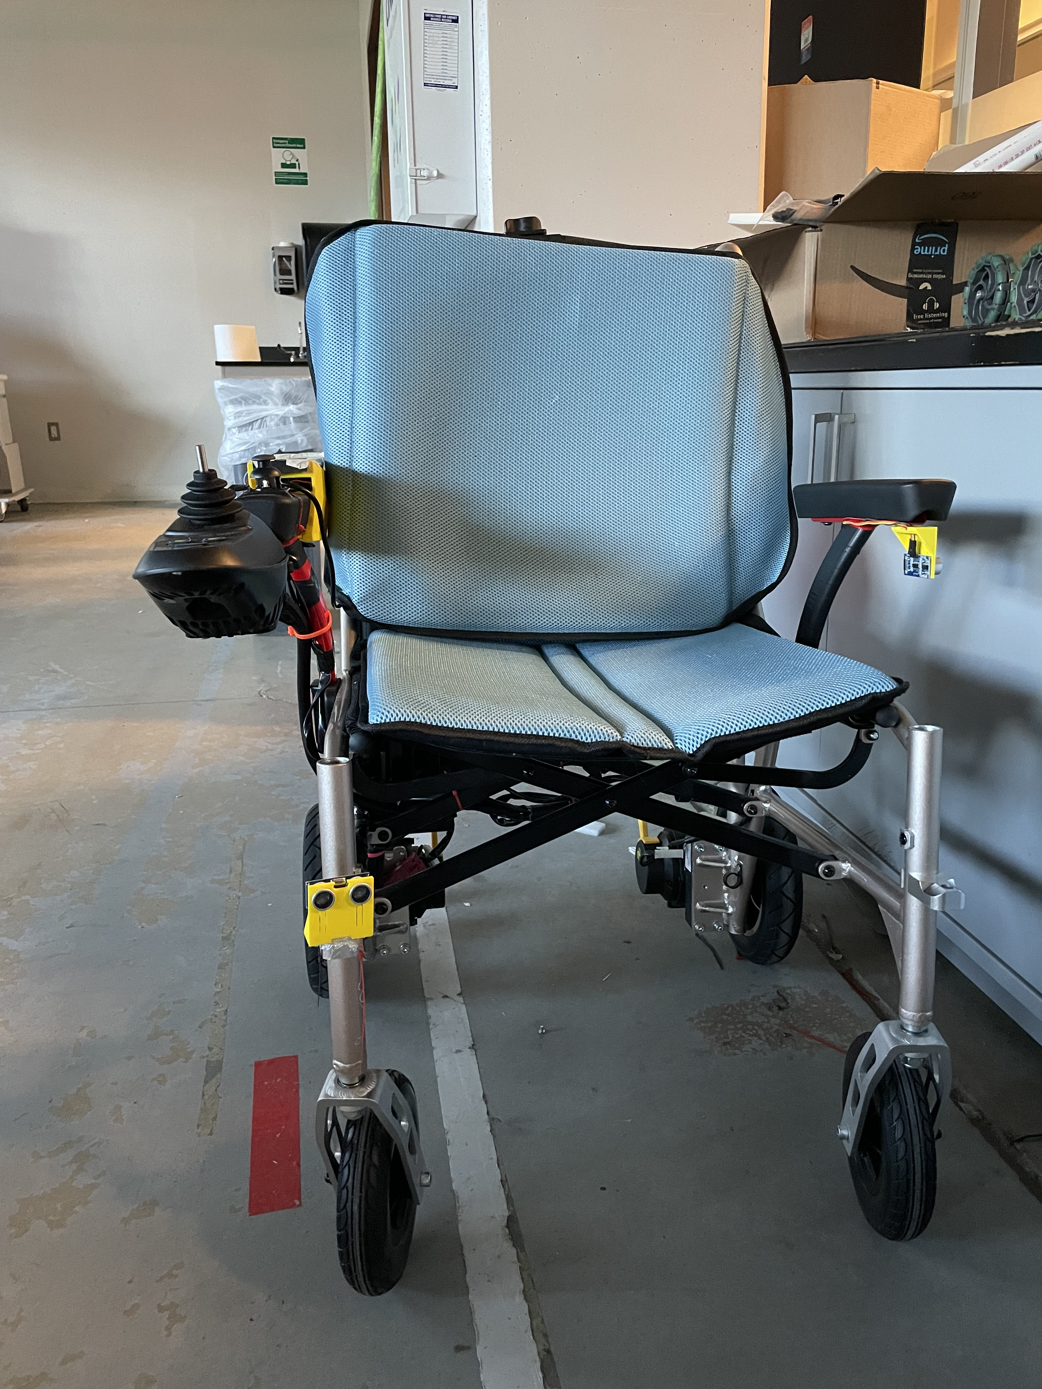
System Overview
An Autonomous wheelchair that will implement LIDAR and a Kinect Camera to maneuver through the world
Python based data interpretation and navigation
Controlled with a user provided laptop and Arduino 2560 Rev3

Slide 3
Block Diagram
Velodyne VLP-16
LiDAR Sensor
Dell Latitude 7285
Laptop
Arduino MEGA 2560 Rev3
Right Motor
MX2206-9
Kinect V2 (Model 1520)
Left Motor MX2206-9
Joystick

Slide 4
Major Parts
Part | Model | Purchased
Frame | Standard motor driven wheelchair with battery | ✔
Microcontroller | Arduino Mega | ✔
Sensors | Velodyne VLP-16, Microsoft Kinect V2 | ✔
Laptop | Dell Latitude 7285 | ✔
Battery | Bioenno Power Lithium Ion Battery | ✔

Slide 5
Major Works
Mechanical assembly completed 35%
Wheelchair base and wiring box are assembled
Laptop mount is being 3-D printed, sensor mounts in design phase
Electrical system completed 60%
All parts have been acquired
Wiring of digital logic between Arduino and wheelchair is complete
Wiring of power and digital signals between sensors laptop and Arduino still to be completed.
Programming completed 30%
ROS packages have been acquired and interfacing with major sensors has been confirmed. Conversion of data transmitted to useable information for Wheelchair still to be completed.

Slide 6
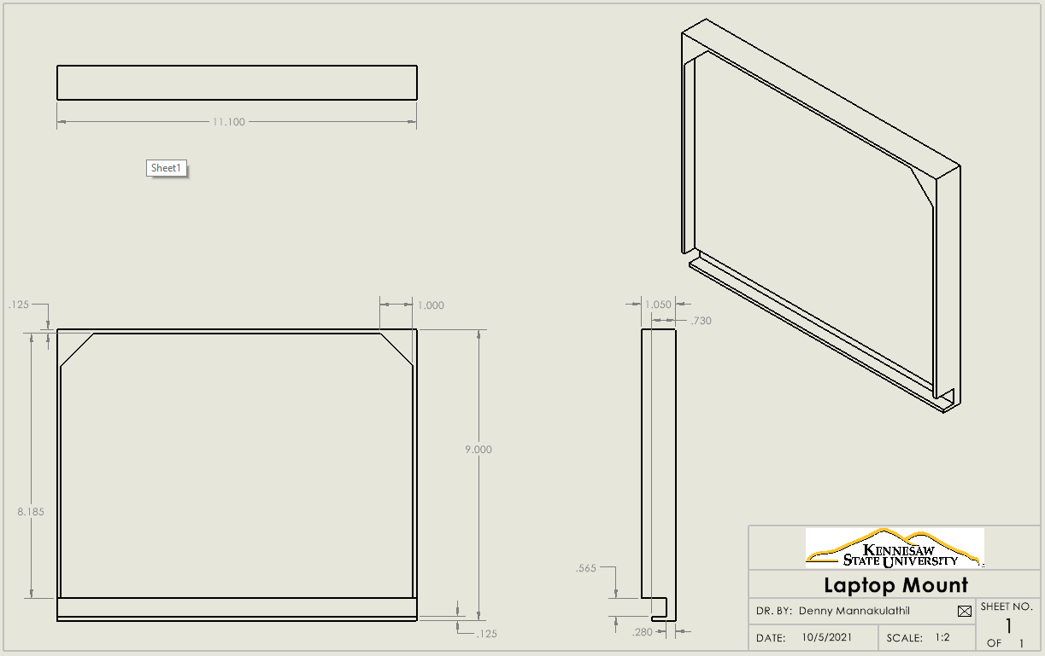
Design Requirements & Specifications

Slide 7
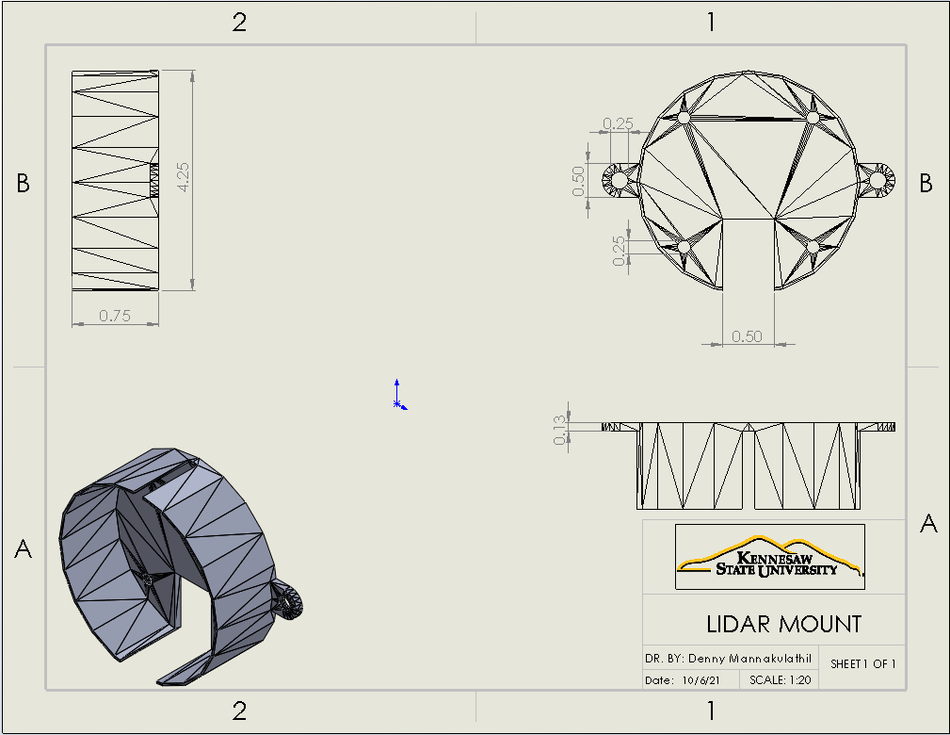
Design Requirements & Specifications

Slide 8
Design Requirements & Specifications
Functions
Avoid both stationary and moving object while navigating
Navigate from start point to finish point autonomously
Path plan and adjust plan using new data collected
Implement SLAM to map the surrounding world

Slide 9
Dimensions
Avoid both stationary and moving object while navigating
Navigate from start point to finish point autonomously
Path plan and adjust plan using new data collected
Implement SLAM to map the surrounding world

Slide 10
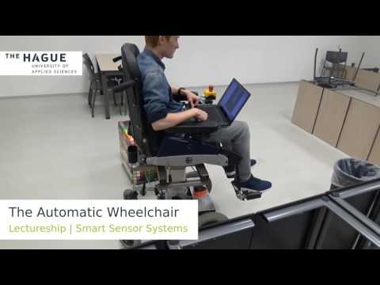
Supporting Video

Slide 11
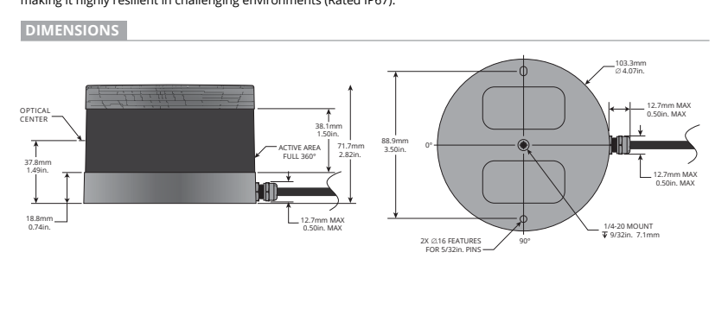
VLP-16 Dimensions

Slide 12
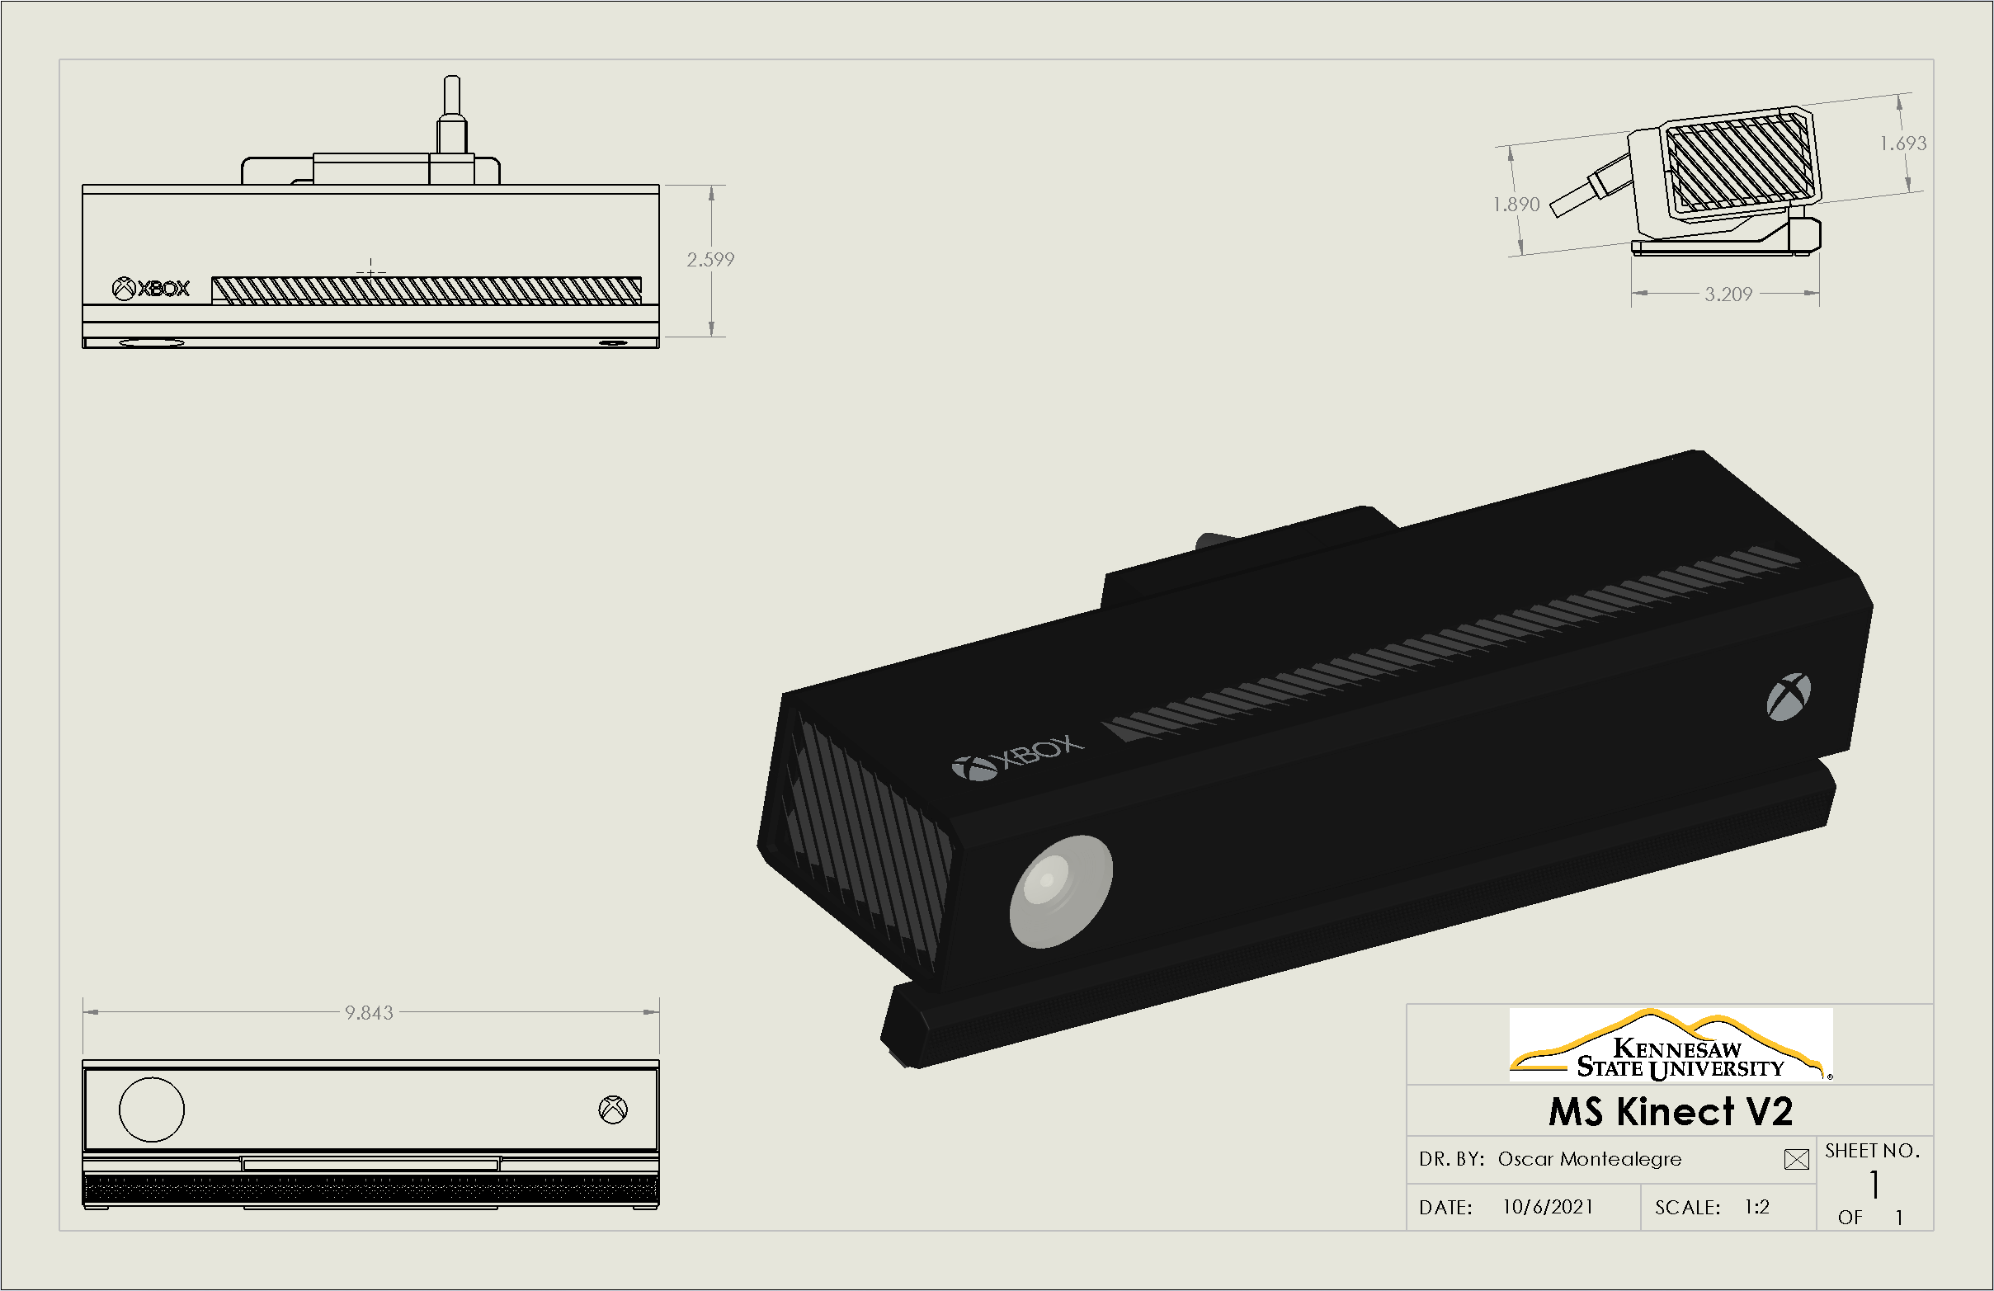
Sensor Diagrams

Slide 13
Basic Design & Trade Study Results
Microcontrollers
Sensors
Battery
Structure

Slide 14
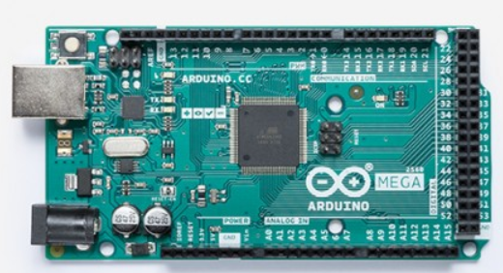
Microcontrollers
Arduino Mega 2560 Rev3
54 digital I/O pins (15 PWM output)
16 analog input pins
4 UARTs (hardware serial ports)
16 MHz Crystal Oscillator (processor)
8 kB of on-board RAM
256 kB of memory
101.52mm X 53.3mm, 37 grams
Source: https://store.arduino.cc/usa/arduino-mega-2560-rev3

Slide 15
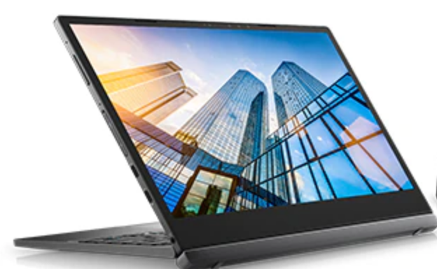
Linux Workstation
Dell Latitude 7285
2-in-1 laptop tablet combination
Intel Core 7th Generation i7-7Y57 Processor
16GB LPDDR3 Memory
12.3" Screen
.28" X 10.8" X 8.2", 680 g
Source: https://www.dell.com/

Slide 16
Linux Machine Weighted Rating Trade Study
Criteria | Weight | Dell Latitude 7285 |  | Raspberry Pi 3.0
 |  | Rating | Weighted | Rating | Weighted
Processor Speed | 0.5 | 4 | 2.0 | 3 | 1.5
Usability | 0.10 | 5 | 0.5 | 3 | 0.3
Memory | 0.2 | 4 | 0.8 | 2 | 0.4
Form Factor | .1 | 2 | 0.2 | 5 | 0.5
Total | 1 |  | 3.5 |  | 2.7

Slide 17
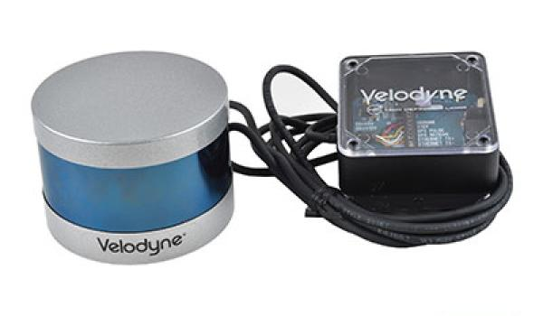
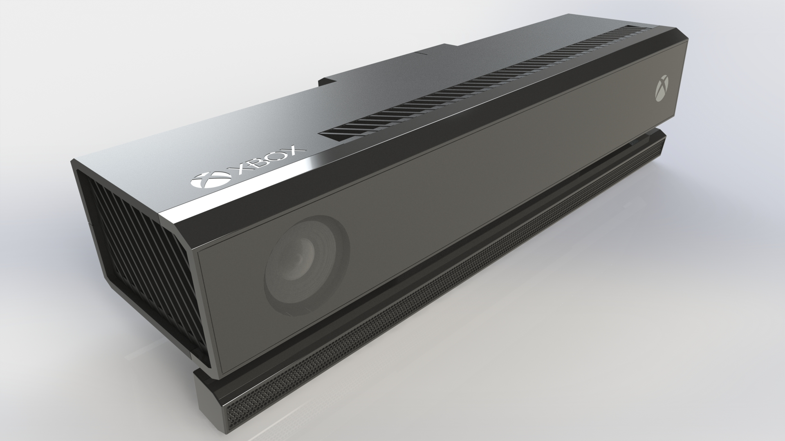
Sensors
Velodyne VLP-16
LiDAR (Light Detection & Ranging) Sensor
Microsoft Kinect V2
Infrared, RGB sensors & Microphone Array

Slide 18
LIDAR Weighted Rating Trade Study
Criteria | Weight | Velodyne VLP-16 |  | MS Kinect V2
 |  | Rating | Weighted | Rating | Weighted
Range | 0.25 | 5 | 1.25 | 2 | 0.5
Frequency | 0.35 | 3 | 1.05 | 2 | 0.7
Angular Range | 0.3 | 4 | 1.2 | 3 | 0.9
Cost | 0.1 | 5 | 0.5 | 5 | 0.5
Total | 1 |  | 4.0 |  | 2.6

Slide 19
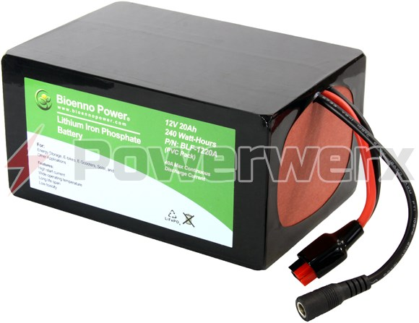
LiDAR & Kinect Battery
Bioenno Power Lithium Iron Phosphate Battery
Capacity - 20 Ah
480 Watt-Hours
Amps - 40 A
Voltage - 12 V
Type - Lithium Iron Phosphate (LiFePO4)
Dimensions – 9.5" X 5.5" X 3.5", 2.4kg
Source: https://powerwerx.com/

Slide 20
Battery Weighted Rating Trade Study
Criteria | Weight | Bioenno 12V |  | Eco-Worthy 12V
 |  | Rating | Weighted | Rating | Weighted
Weight | 0.2 | 3 | 0.6 | 4 | 0.9
Amps | 0.1 | 3 | 0.3 | 3 | 0.3
Size | 0.2 | 4 | 0.8 | 2 | 0.4
Cost | 0.5 | 5 | 2.5 | 2 | 1.0
Total | 1 |  | 4.2 |  | 2.6

Slide 21
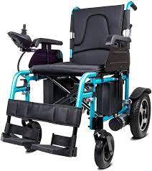
Wheelchair Structure
Seat Height: 19 in.
Seat Depth: 19 in.
Back Height: 36 in.
Width: 23 in.
Rear Wheel Radius: 4.75 in.
Front Wheel Radius: 3 in.
One 120 watt motors mounted
on each back wheel
Material: Aluminum with cloth seat

Slide 22
Frame Weighted Rating Trade Study
Criteria | Weight | Yurob Portable |  | Electra 7 |  | Falcon Portable
 |  | Rating | Weighted | Rating | Weighted | Rating | Weighted
Weight | 0.2 | 4 | 0.8 | 2 | 0.4 | 2 | 0.4
Foot Print | 0.2 | 3 | 0.6 | 2 | 0.4 | 2 | 0.4
Motor Interface | 0.3 | 4 | 1.2 | 3 | 0.9 | 3 | 0.9
Cost | 0.3 | 5 | 1.5 | 2 | 0.6 | 3 | 1.0
Total |  |  | 4.10 |  | 2.30 |  | 2.70

Slide 23
Verification Approach/Plan
Analysis
Path planning analysis
Modify path planning and obstacle avoidance algorithms
Simulation
SolidWorks Models of 3D printed parts
Obstacle avoidance Gazebo
Test
Testing of sensors prior to implementation
Testing of wheelchair using Joystick
Obstacle avoidance testing in the real world

Slide 24
Verification Approach/Plan (cont.)
Systems​ | Analysis​ | Model​ | Simulation​ | Testing​
Mechanical​ | ✔​ | ✔​ | ✔​ | ✔​
Motors​ | ​ | ​ | ​ | ✔​
Batteries​ | ✔​ | ​ | ​ | ✔​
Microcontroller​ | ✔​ | ​ | ​ | ✔​
Sensors​ | ✔​ | ​ | ✔​ | ✔​

Slide 25
Design & Development
Avoid both stationary and moving object while navigating
Navigate from start point to finish point autonomously
Path plan and adjust plan using new data collected
Implement SLAM to map the surrounding world

Slide 26
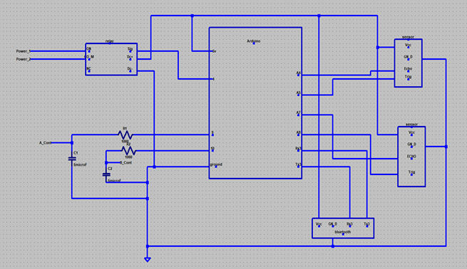
Digital Wiring Diagrams

Slide 27
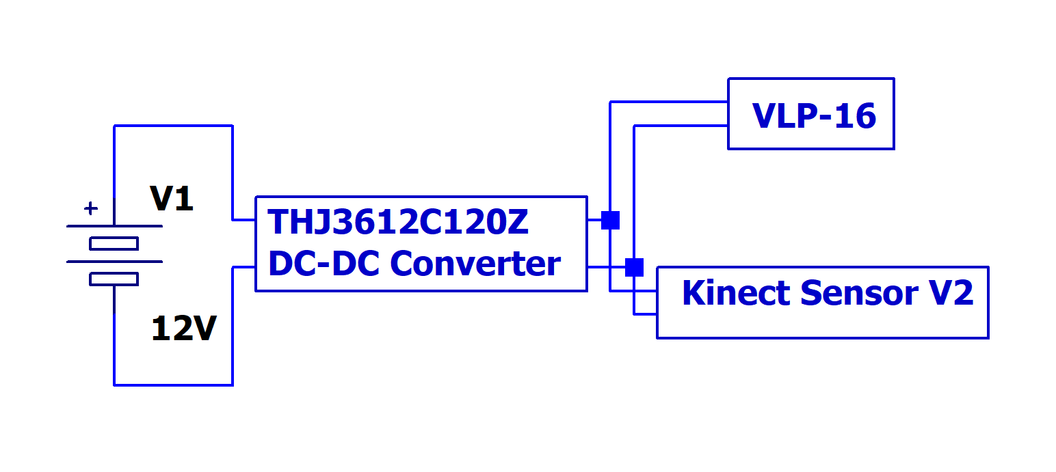
Power Wiring Diagrams

Slide 28
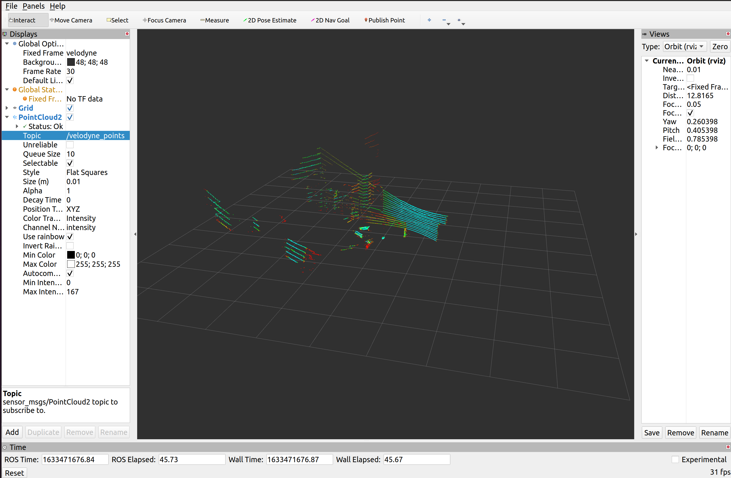
Velodyne PointCloud

Slide 29
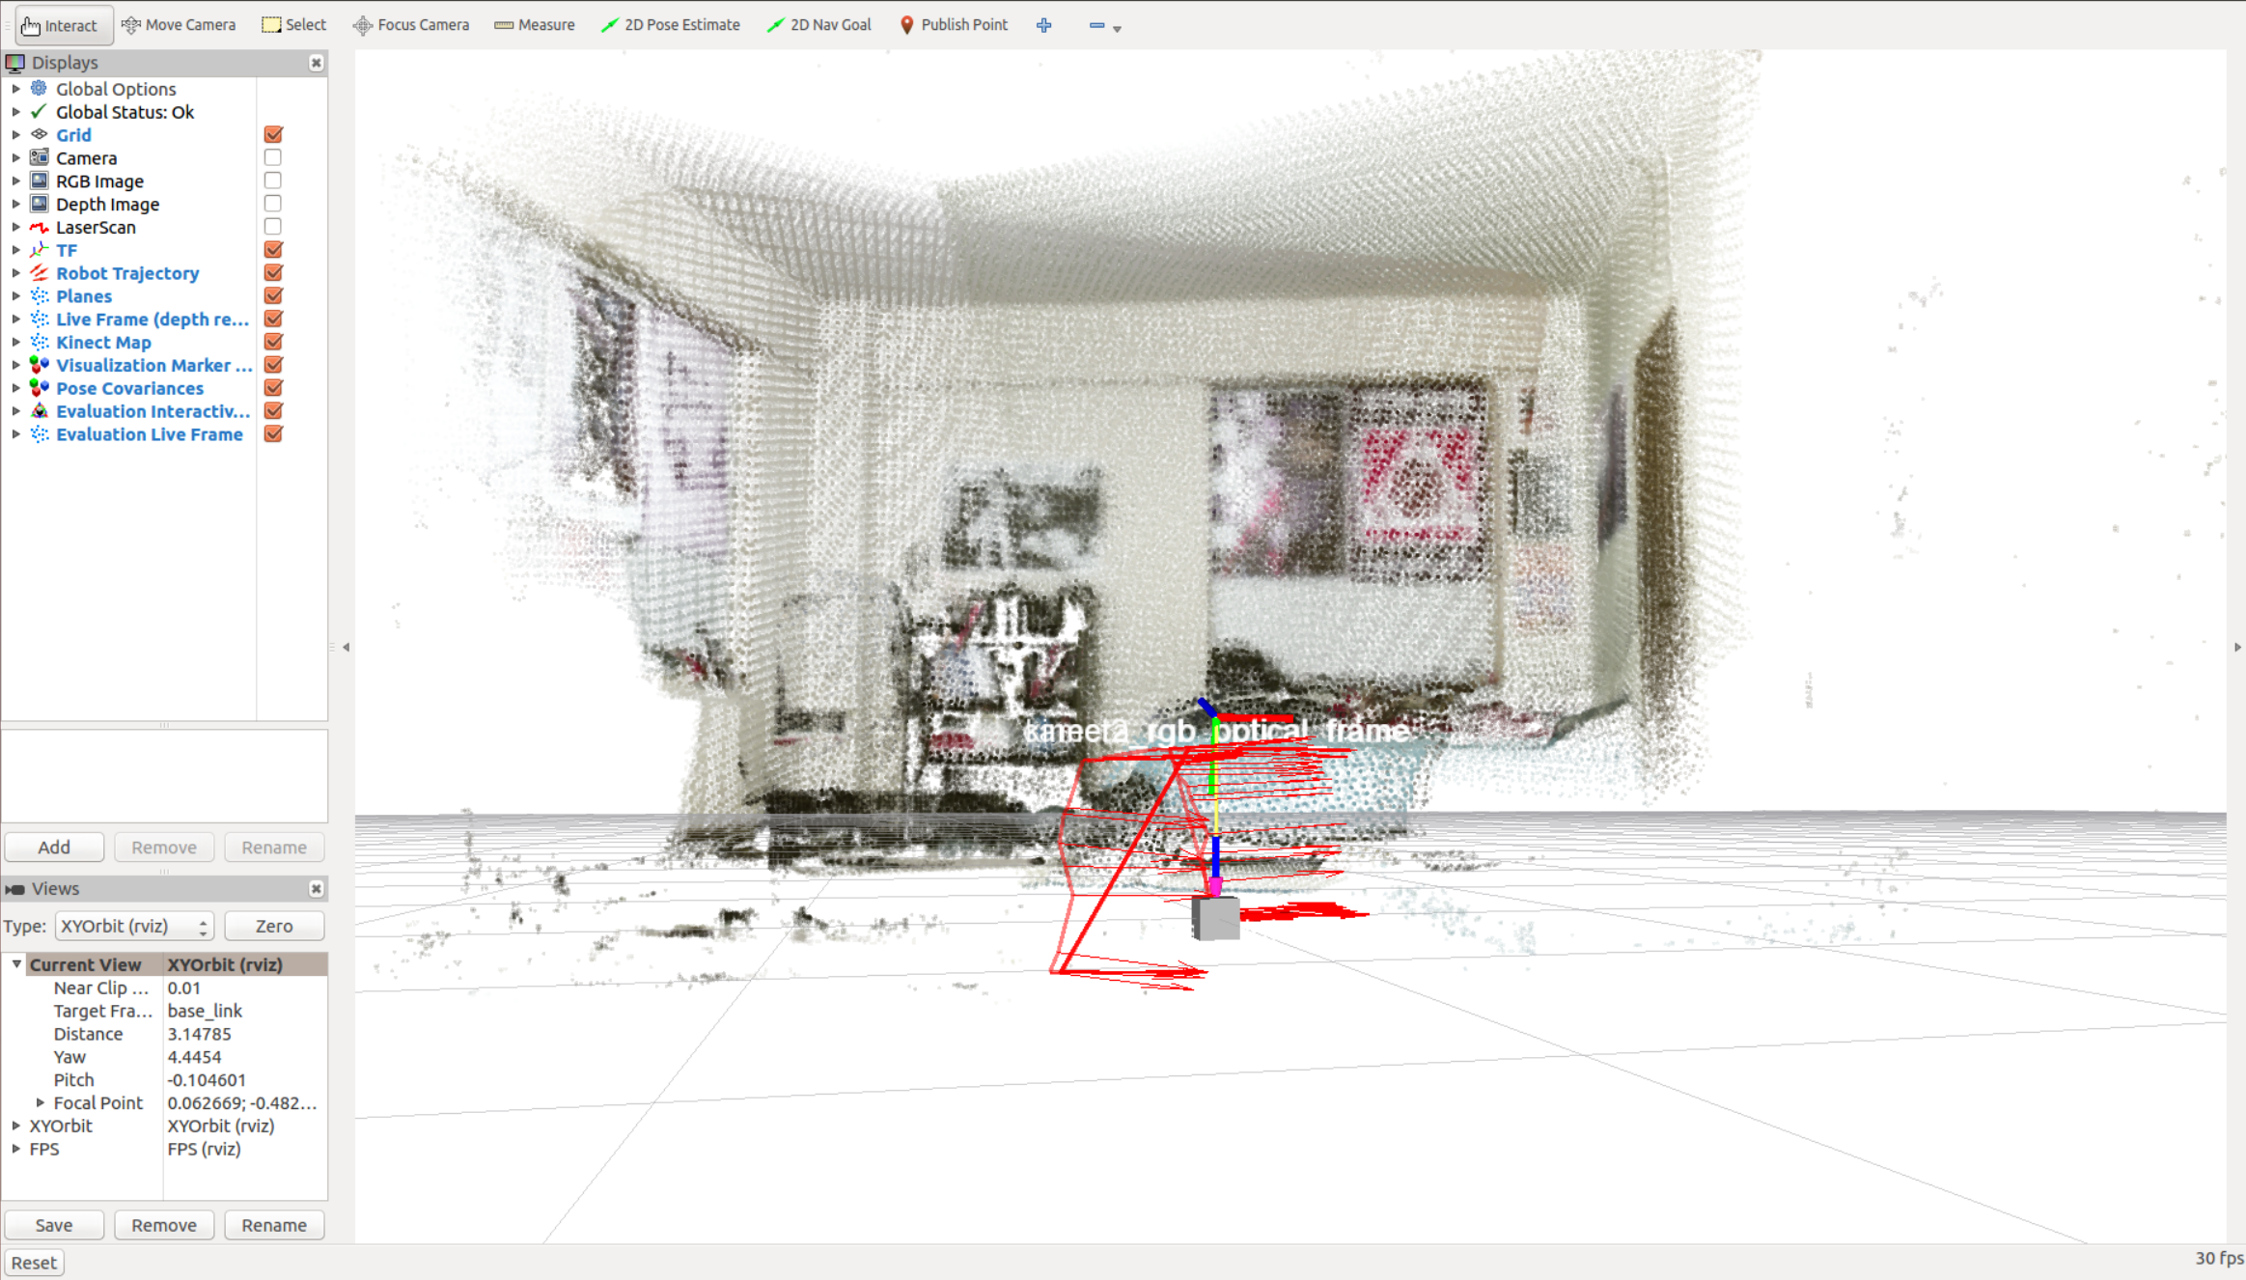
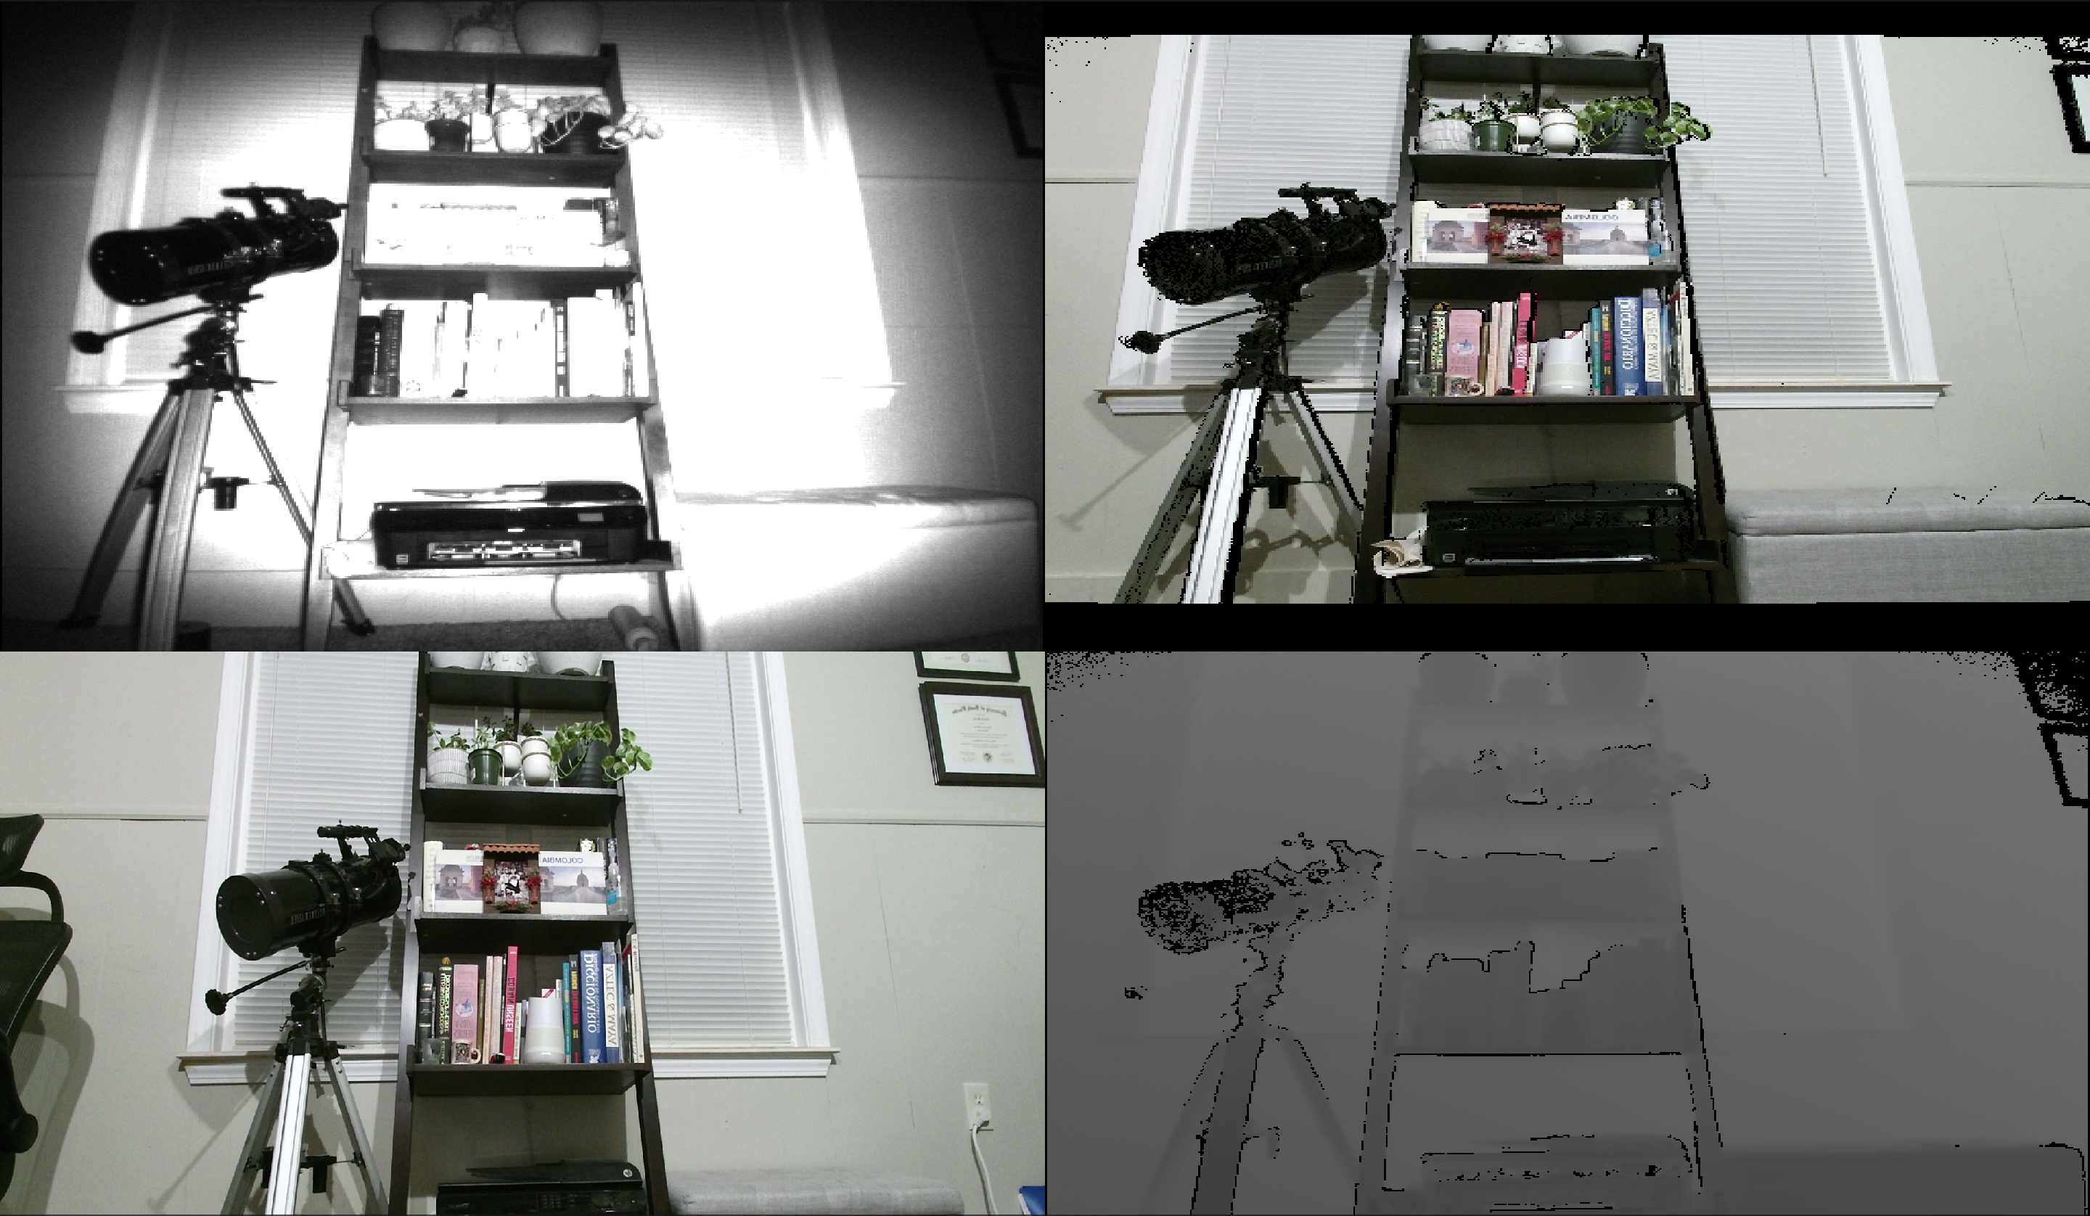
Kinect RGB & Infrared Visualization

Slide 30
Bill of Materials
Description | Quantity | Cost per Unit | Cost Total
Electric Wheelchair | 1 | $1,000.00 | $1,000.00
LIDAR | 1 | $4,000.00 | $4,000.00
Kinect Camera | 1 | $40.00 | $40.00
Bioenno Battery | 1 | $193.00 | $193.00
Mounting Hardware | 1 | $53.00 | $53.00
Arduino 2560 | 1 | $40.00 | $40.00
Electrical Wires Multipack | 1 | $16.00 | $16.00
Resistor Multipack | 1 | $12.00 | $12.00
Dell Latitude 7285 | 1 | $1,200.00 | $1,200.00
Bread board | 1 | $5.00 | $5.00
Total |  |  | $6559

Slide 31
Minimum Success Criteria
Navigate to a target point with an error of less than or equal to 4 Feet.
Avoid wall and stationary objects in desired path not moving closer than 2 feet.
Avoid a moving object that passes in front of the wheelchair while navigating to the target point using LiDAR and Kinect for object recognition.
Will be able to navigate to a point 50 feet away at a minimum rate of 3 mph.

Slide 32
Design Optimization/Improvements
Voice command recognition using Kinect Microphone and python packages
Manual joystick replacement
Alternative path planning algorithms
Improve wiring of digital signals
Exhaustive obstacle avoidance (including variation in elevation)

Slide 33
Resources
Mentors Chris Voicu Facility Engineering Lab Q-118 Senior Design Lab | Hardware LIDAR Sensor Ultrasonic Sensors Arduino MEGA Wheelchair Frame Kinect Camera Dell Latitude 7285 Software Solidworks AutoCAD Electrical Ubuntu 20.04 C++/Python/ROS

Slide 34
Project Budget
Item(s) | Price ($)
Sensor Adapters | $30
Battery Mount Hardware | $40
Sensor Mount Hardware | $30
Misc Parts/Material | $50
Total (with contingency) | $150

Slide 35
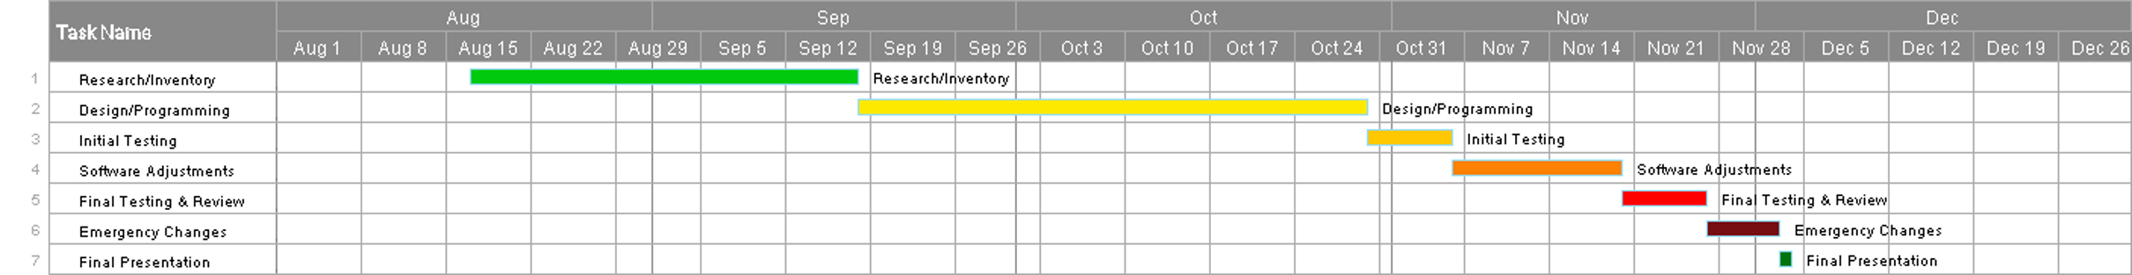
Schedule

Slide 36
Team Chart
Max Bronson – Team Lead, LiDAR Interfacing, ROS & Arduino Programming
Denny Mannakulathil – Solidworks Modeling, 3-D Printing, Mechanical Assembly
Oscar Montealegre – Kinect Interfacing, Object Identification, ROS programming

Slide 37
References/Major Data Sheets
References
LiDAR reference 1
Autonomous wheelchair reference
OpenCV reference
Python reference
Solidworks reference 1
Solidworks reference 2
Solidworks reference 3
Solidworks reference 4
Data Sheets
LIDAR Datasheet
Kinect Datasheet
Notes:
Possibilities:
Raspberry Pi Manual
Lidar Technical Sheet
Pixhawk PX4 Manual
ETC

